Slide 1
Introduction to Time-Varying Effects Models (TVEM)
Slides Courtesy of the Methodology Center at Penn State University
methodology.psu.edu

Slide 2
Outline
Conceptual Introduction to TVEM
  Types of Questions
  Data Considerations
TVEM Step-by-step
  Research Question
  Data Organization
  Model Specification
  Interpretation of Output
  Example in Logistic TVEM

Slide 3
Conceptual introduction to
Time-Varying Effect Modeling

Slide 4
Why TVEM? Examining effect of intervention on heavy drinking
Intervention conducted to reduce alcohol abuse
Post-Baseline Measurement
  One time point
  Two time points
  Multiple time points

Slide 5
Effect of Intervention: One Time Point
Evaluating the effect of an intervention at one timepoint indicates that the intervention group decreased their HED while the placebo remained contant.

Slide 6
Effect of Intervention: Two Times
Adding a second time point shows that the difference between placebo and intervention is getting smaller over time—suggesting intervention effects may be time-varying.

Slide 7
Effect of Intervention: Multiple Times
Adding more followup time points further demonstrates how the intervention effect CHANGED over time – but not in a way that can be captured by a linear model.

Slide 8
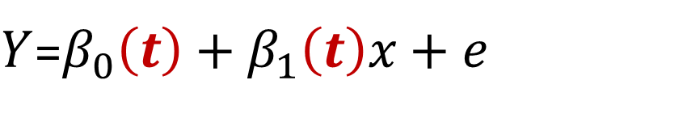
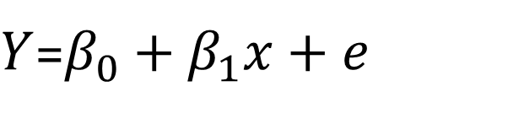
TVEM vs Regression
Regression coefficients express associations between variables
Traditional regression of Y on a predictor X
TVEM incorporates time in the regression equation. Now, we can evaluate whether and how the effects of covariates change over time
TVEM allows for dynamic estimation of coefficients
  Natural shape of the coefficient is estimated rather than forcing the coefficient to constrain to a shape (linear, quadratic)
$Y$=$β_{0}+β_{1}x+e$
$Y$=$β_{0}\left(t\right)+β_{1}\left(t\right)x+e$

Slide 9
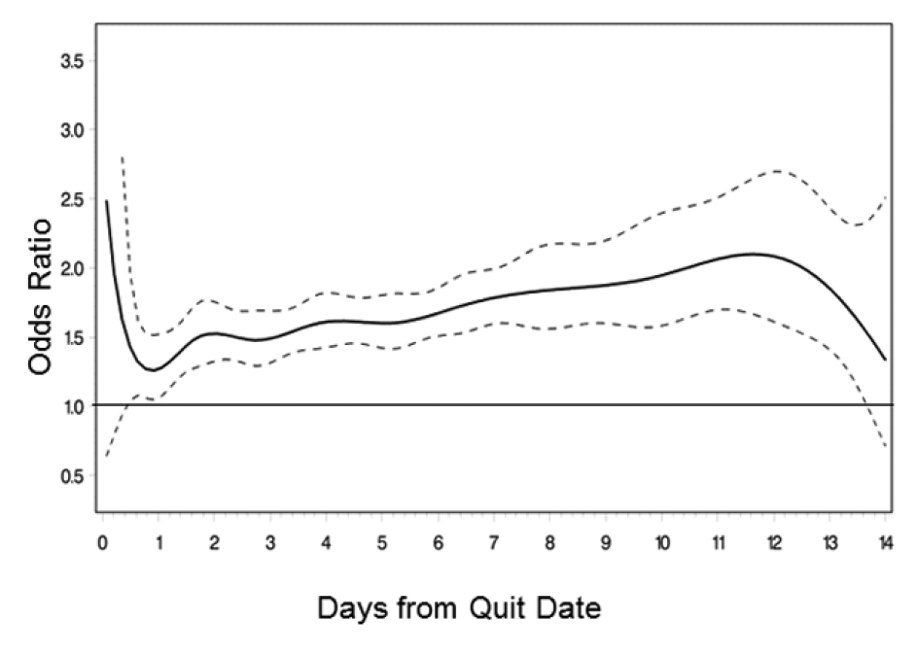
What is estimated?
Time-Varying Association between Craving and Smoking Lapse
In TVEM, we estimate regression coefficients (i.e., associations) as flexible functions of continuous time
Use figure and output to interpret a “coefficient function”
Provides 95% confidence intervals to assess significance over time
Estimated coefficient
95% confidence intervals
Time
Notes:
Add explanatory notes

Slide 10
Types of questions TVEM can answer
Age (Developmental Time)
Mean levels and associations are dynamic with age
Example: Vasilenko & Lanza (2014) Journal of Adolescent Health
  How does salience of risk factors for having multiple sexual partners unfold with age?
Rates of Multiple Partners by Age
Male
95% CI
Male
Female
95% CI
Female
Proportion of individuals having sex with multiple partners by age is significantly different for men and women in late 20s.
Notes:
ADD associations example?

Slide 11
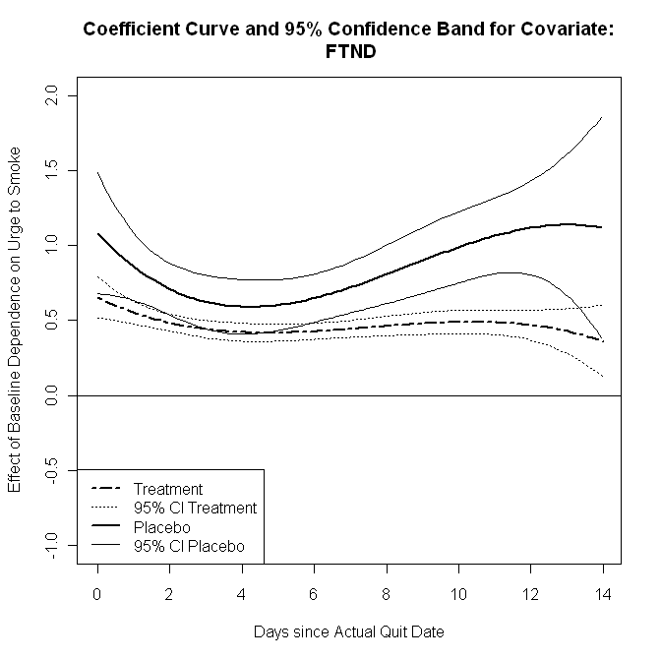
Types of questions TVEM can answer
Effect on Craving: Baseline Dependence
Time from Event:
Associations among variables change as function of time from event
Example: Lanza et al., (2014) Nicotine and Tobacco Research
  How do predictors relate to craving over 14 days post-quitting cigarettes?
Treatment group shows significantly weaker association between dependence and craving during second week after quit.

Slide 12
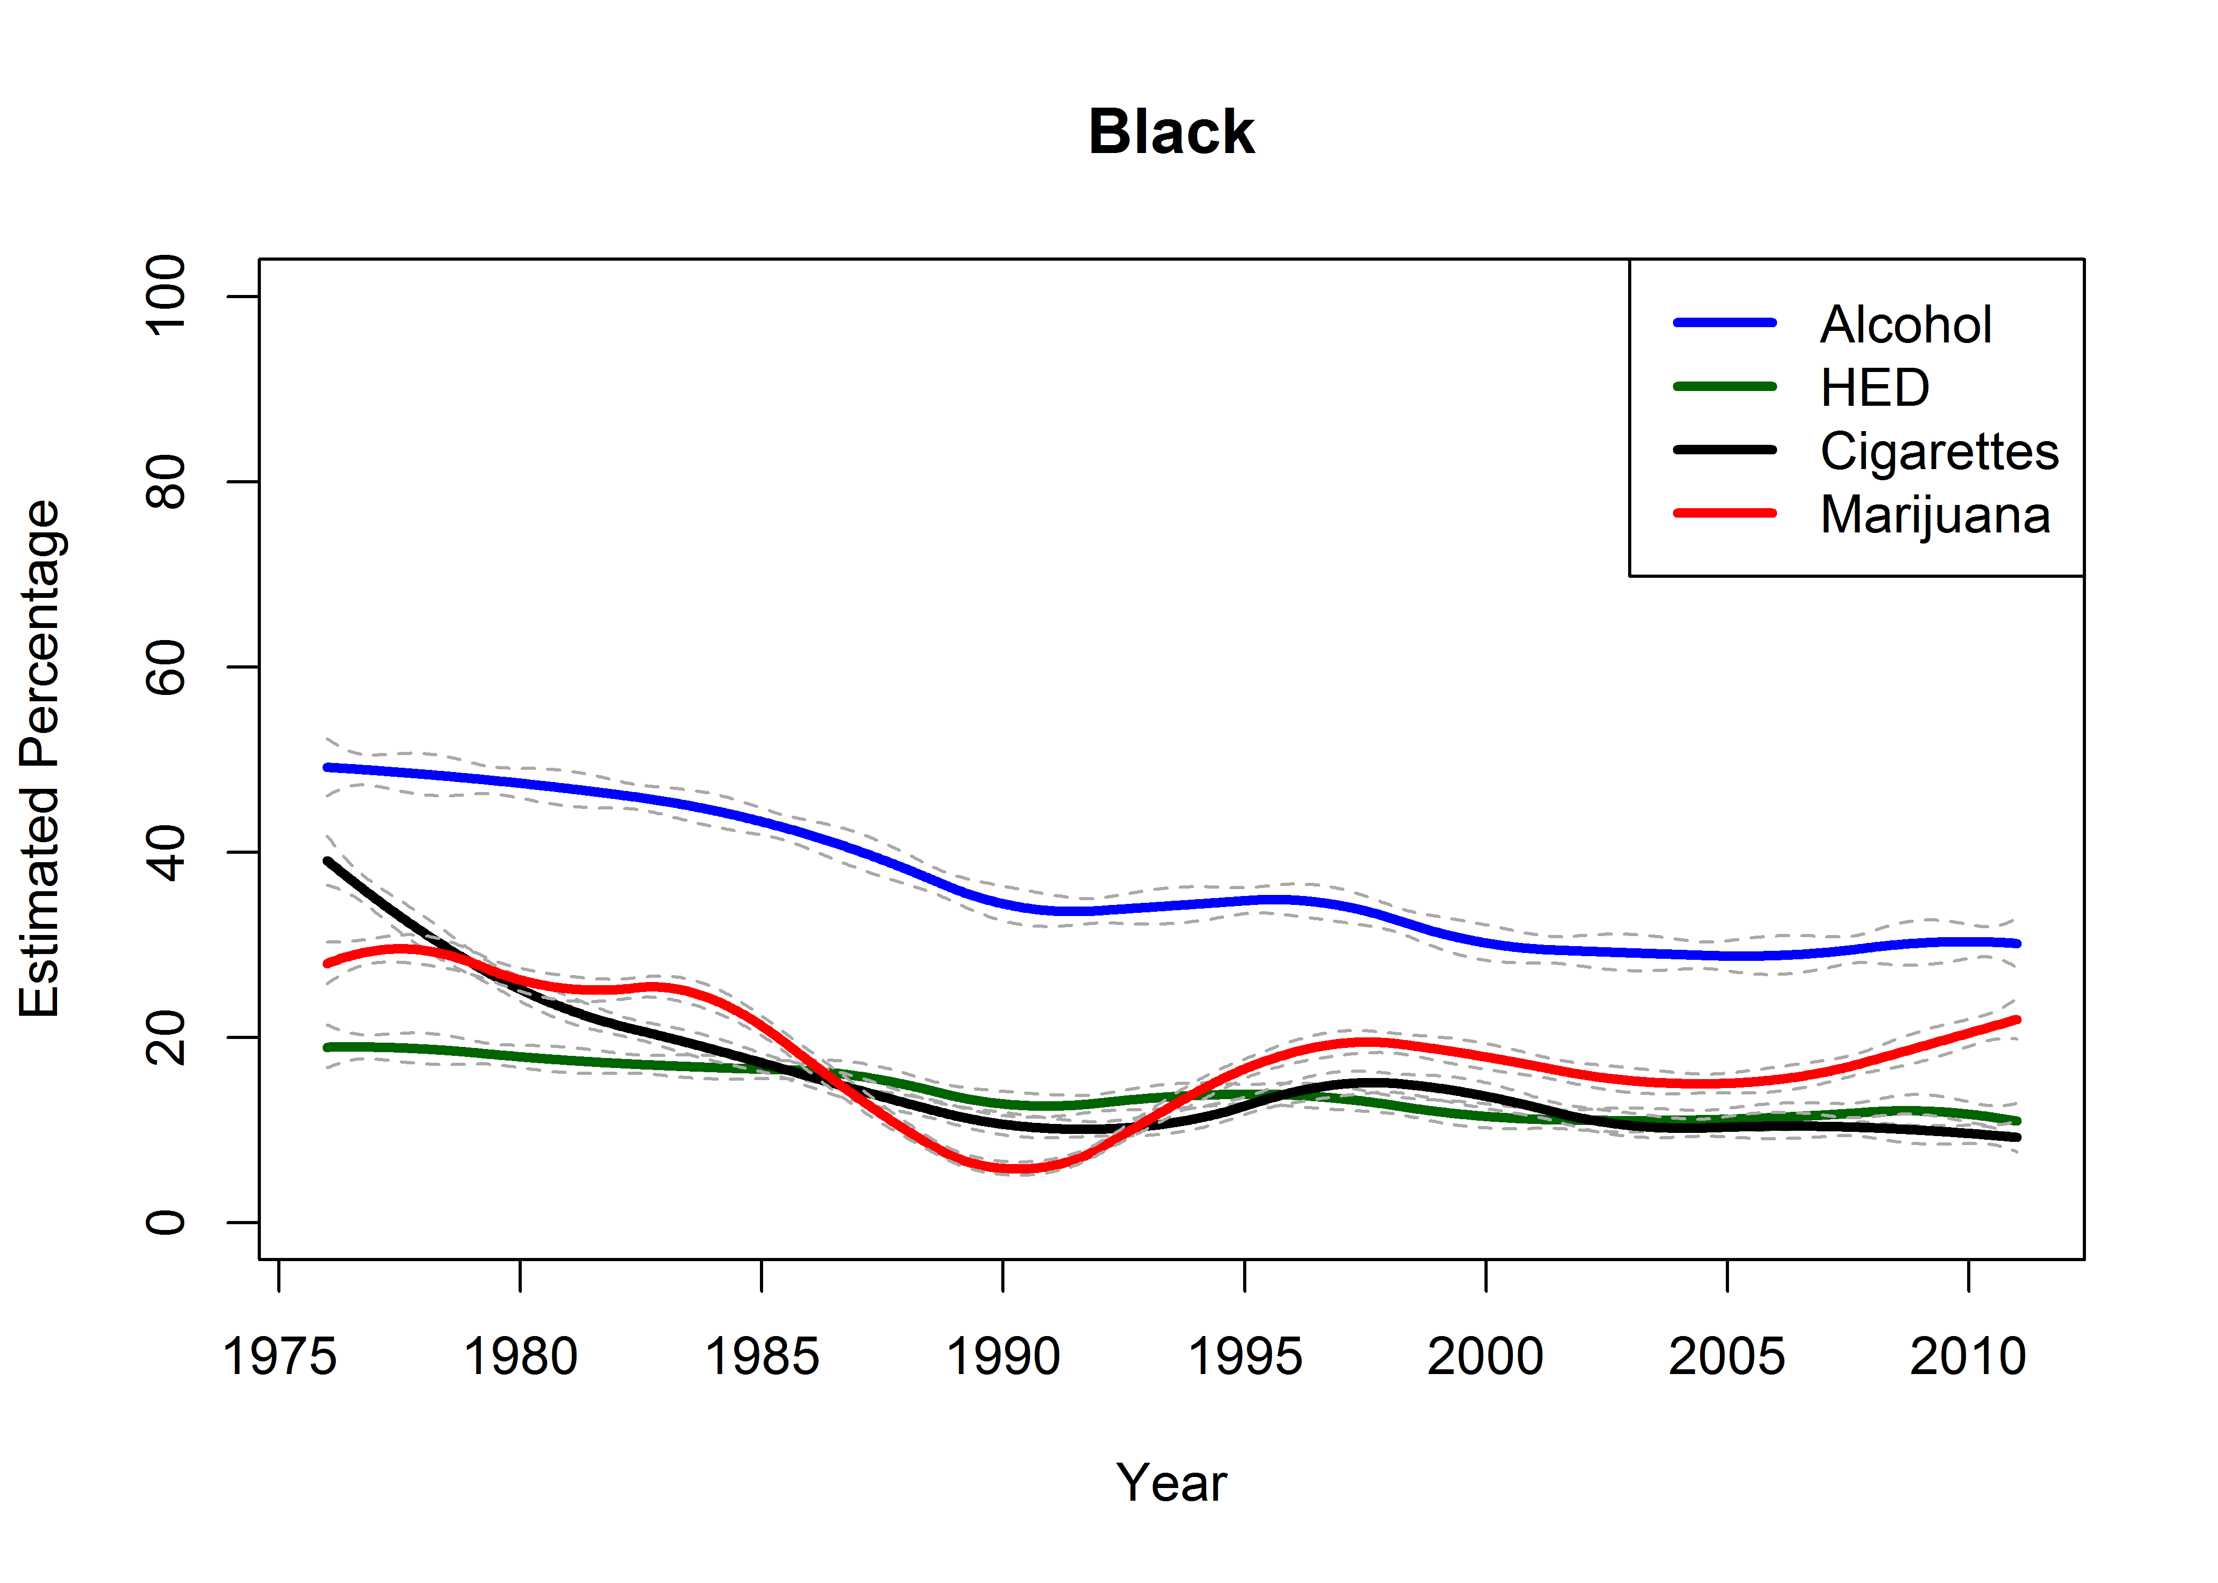
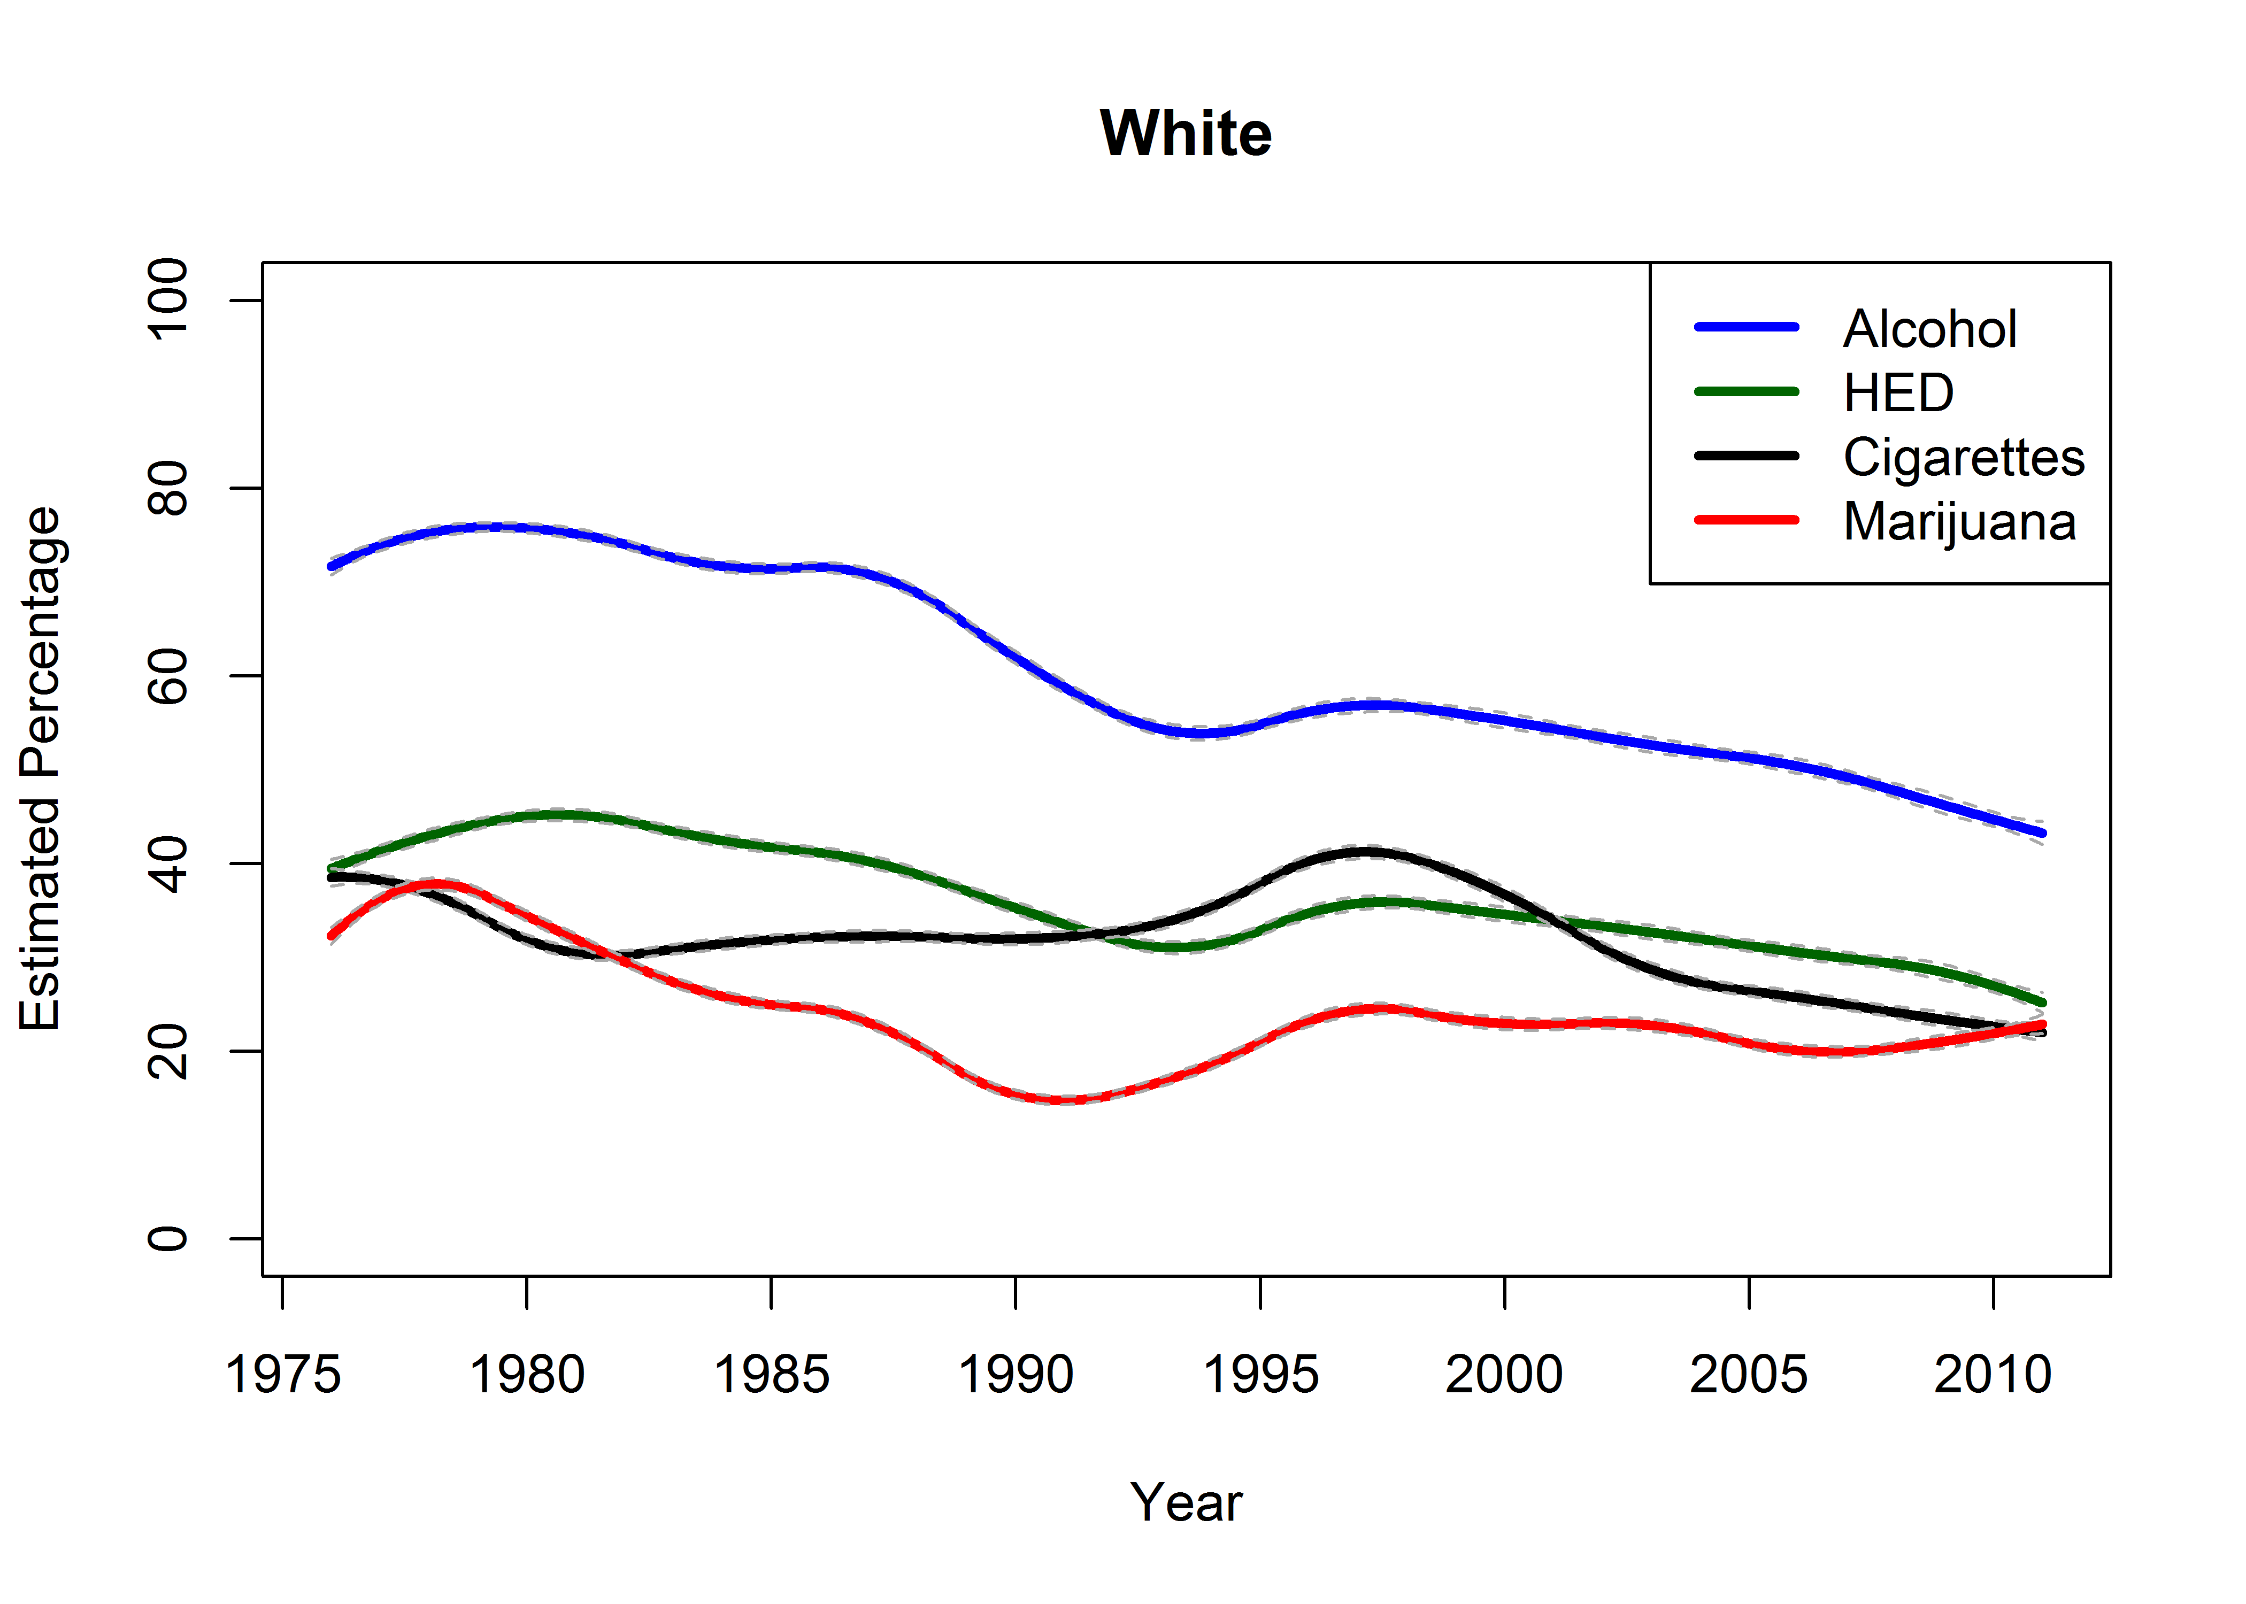
Types of questions TVEM can answer
Historical time (years)
Levels, prevalence, and associations can change across years
Example: Lanza et al, 2015, Journal of Adolescent Health
  Trends in substance use among U.S. high school seniors by race
Black Youth
White Youth
Black and white youth demonstrate different patterns of substance use over historical time.

Slide 13
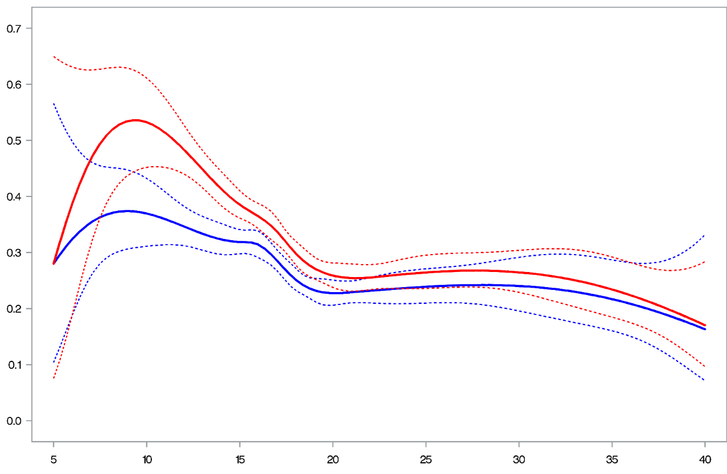
Types of questions TVEM can answer
Timing/age of onset of event
Outcomes may differ depending on when individuals first experienced an event
Example: Lanza & Vasilenko, 2015, Addictive Behaviors
  Identify precise age ranges during which onset of regular smoking confers highest risk for adult nicotine dependence
Male
95% CI
Male
Estimated Prevalence of Dependence
Female
95% CI
Female
Males
Age of Onset
Individuals who started smoking earlier have higher prevalence of dependence; women have higher prevalence than men at age of onset between 10 and 20.

Slide 14
Types of questions TVEM can answer
Non-time questions:
  “Time” is in the name, but any continuous variable can be used instead of time
  Essentially a nuanced way of examining a continuous moderator
Example: Selya et al., 2015, Addictive Behaviors
  Examines how associations between smoking and mood change as a function of level of nicotine dependence
  Nicotine dependence serves as the “time” variable

Slide 15
Data Considerations
Meaningful centering/alignment point
  Needs to be time from some meaningful zero
  Potentially problematic: EMA study assessing a “typical week”—no time anchor
Coverage across the entire time span of interest
  Need to have all times/ages assessed near continuously
  Potentially problematic: Birth cohort study with data every 5 years
The same measures at all waves of data collection
  Can be challenge in long-term longitudinal studies

Slide 16
Types of Data that can be used in TVEM
 | Type 1. Cross-Sectional | Type 2. Panel (repeated measures) | Type 3. Intensive Longitudinal Data (ILD)
Description of Data | Data captured from population at one specific point in time | Study that involves repeated observations of same variables at 2 or more time points (waves) | MANY repeated observations of the same variables (typically >20)
Participant Follow-up | Participants not followed prospectively Participants only interviewed/assessed once | Participants followed prospectively for two or more waves | Participants followed prospectively for many assessments (not called waves)
Example Paper | Fish et al., 2018, Prevention Science | Vasilenko 2017, Developmental Psychology | Cook et al., 2017, Nicotine and Tobacco Research

Slide 17
Types of dependent variables in TVEM
Continuous outcomes
  Linear model
Binary outcomes
  Logistic model
Count outcomes
  Poisson model
  Zero-inflated Poisson (count data that is drastically skewed with many zeroes)
    In separate TVEM ZIP macro

Slide 18
TVEM ANALYSIS: A Step by step Example

Slide 19
Step 1: Generate a Time-Varying Research Question
How does the prevalence of past-year heavy episodic drinking (HED) differ across ages 12 to age 32?
How does the association between depressive symptoms and HED vary across ages 12 to age 32?

Slide 20
Step 2: Organize Data and Recode Variables
If using longitudinal data you need a long format dataset (multiple rows per person)
  Recode all variables so there is one time-varying measure of each (e.g., a participants has a value on the variable at W1, W2, etc)
Confirm there is adequate coverage across continuous age
Create a new variable with a value of 1 for each row in the data set (for calculating intercept function)

Slide 21
Example Data
National Longitudinal Study of Adolescent Health to Adult (Add Health; Harris, 2011)
  Public Use Dataset
  4 waves of data collected from adolescence through adulthood
Cohort sequential design (Nesselroade & Baltes, 1979)
  Across individuals and waves, sufficient coverage from ages 12-32
N=6,505 individuals, 21,208 measurement occasions

Slide 22
Recoding the Measures
Data were in separate files for the four waves
  4 different names for variables
Recoded variables to be consistent across waves
  Renamed to indicate wave (e.g., dep1, dep2, dep3, dep4)
Merged into a single (long) file with one variable’s values at up to 4 occasions (e.g., dep)
Created a variable to estimate the intercept which is equal to 1 for all rows (i.e., a column of 1s)

Slide 23
Example Measures
Outcome: Past year HED
  Binary variable
Predictor: Depressive symptoms
  Continuous scale
Time Variable: Age in months

Slide 24
Recoded Dataset
Predictor: Depressive Symptoms (dep)
Outcome: HED (PYBNGE)
Time Variable: Age (calcage)
Created Intercept Variable: (x0)
Multiple Rows per Participant

Slide 25
Step 3: Specify model
Variables in the dataset may be time-varying or time-invariant
  Time-invariant (don’t change across chosen continuous time variable):
    Examples: Age first tried drinking, Race/ethnicity
  Time-variant (may change across continuous time):
    Example: current smoking status, assessed at each time
Choose whether variables will have time-varying or time-invariant effects
  Both types of variables can be specified to have time-varying (or time-invariant) effects
  E.g., the effect of being male on heavy drinking may differ across age (the time-varying effect of a time-invariant variable)

Slide 26

Specify model: Parameters
Logistic time-varying effect model (TVEM):
Both intercept and slope are time-varying
  𝛃₀ (t) indicates age-varying prevalence of the log-odds of HED
  𝛃₁ (t) indicates age-varying effect of depression on the log-odds of HED
Can also add time invariant effects (none in this model)
$$log ⁡\left[\frac{p \left(HED\right)}{1−p \left(HED\right)}\right]=β0\left(t\right)+β1\left(t\right)DEP$$

Slide 27
Specify model: Splines
Select B-spline or P-spline estimation method
  B-spline basis function
    More computationally stable in some cases
    Selects more complex model to reveal more nuanced changes
    Need to do model selection manually
  Truncated power spline basis functions (P-spline)
    Selects less complex model; may oversmooth curve
    Model selection completed automatically
More information in the TVEM User’s Guide

Slide 28
Specify model: Knots
Complexity of a model is determined by the number of knots (splitting points)
A number of knots needs to be selected for every time-varying effect in the model
Approach varies by spline basis
  In b-spline, run multiple models and comparing fit statistics.
  In p-spline, model selection (i.e., number of knots) is done automatically.
In these examples, we will show the simplest method, which is a p-spline model with a maximum of 10 knots specified for each parameter.

Slide 29
Step 4: Run Model
Go to http://methodology.psu.edu/downloads/TVEM
Download %TVEM macro and user’s guide. Extract into folder
Run %INCLUDE statement in SAS to point to location of macro on your computer
Run LIBNAME statement in SAS to point to location of data on your computer
Specify and run the TVEM model you wish to estimate

Slide 30
Anatomy of the Macro: Key Statements
%TVEM(data = dataset name,
id = variable,
time = variable,
dv = variable,
tvary_effect = intercept variables,
knots = numbers,
dist = distribution name,
method = name);
id: subject ID
time: the continuous time variable
tvary_effect: variables to examine time-varying associations with outcome
*MUST INCLUDE INTERCEPT (intercept = 1)
dv: dependent variable
knots: the number of splitting points for each time-varying parameter
dist: outcome distribution - normal, binary or poisson
method: P or B spline
Notes:
I added knots box but that messed up the formatting. Aaron, can you make it look a bit nicer?

Slide 31
Anatomy of the Macro: Two Sample Models
Intercept Only Model
Time-Varying Slope Model
%TVEM(data = example,
id = AID,
time = calcage,
dv = pybnge,
tvary_effect = x0,
knots = 10,
dist = binary,
method = p-spline);
%TVEM(data = example,
id = AID,
time = calcage,
dv = pybnge,
tvary_effect = x0 dep,
knots = 10 10,
dist = binary,
method = p-spline);
Calculates the estimated prevalence of HED at every age (when coefficients converted to prevalence)
Calculates the effect of depressive symptoms at every age (as well as an intercept function of HED).

Slide 32
Output produced by TVEM macro
SAS data set (“plot data”) containing estimates of all coefficeints and corresponding 95% confidence intervals across time
This information is also presented in plots to show how they change over time
Can also export plot data and create plots in your preferred plotting program (e.g., SAS PROC GPLOT, Excel, R)

Slide 33
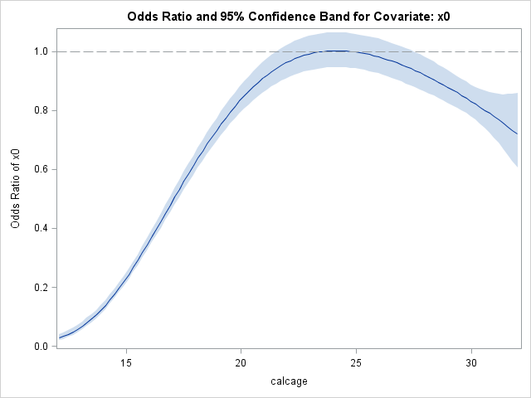
TVEM Output: Intercept Function
Macro will produce age-varying beta plots (average level at different ages) for continuous outcomes
Will produce both betas and odds for binary outcomes for intercept.
Can convert to prevalence for easier interpretation

Slide 34
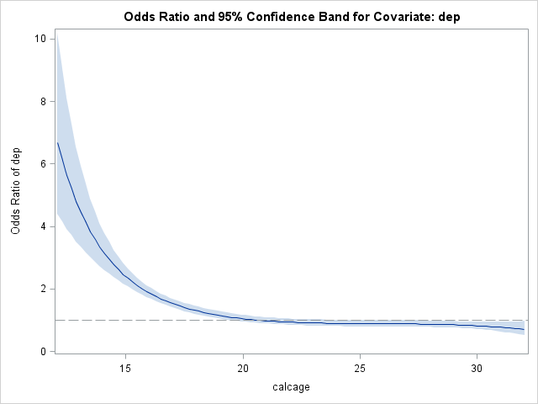
TVEM Output: Coefficient Function
Macro will produce beta plots for continuous outcomes and both betas and odds ratios for binary outcomes.
Odds ratios make for easier interpretations in logistic models.
Effect is significant if the confidence interval does not overlap with the line at 1.
Interpret like an odds ratio at each age
e.g., a 1 unit increase in depressive symptoms is associated with 2.5 times greater odds of HED at age 15.

Slide 35
Weighted TVEM Also Available
Weighted TVEM macro can incorporate weights
  Typically used with nationally representative data
Weighted macro also useful for examining differences by subgroup without loss of sample size (See “domain” statement)
See Weighted TVEM User’s Guide for more information and Vasilenko et al., 2017, Journal of Research on Adolescence for an example.

